Slide 1
UNIVERSITY GRADE & ATTENDANCE TRACKER
Team No :- 19
B.Bhavya Sarika – 2620030233
J.Gayathri - 2620030290

Slide 2
Abstract
The University Grade and Attendance Tracker is a Java-based application used to manage student marks, grades, and attendance. It helps maintain student records, calculate grades, and display academic performance reports efficiently.

Slide 3
Understanding Problem Statement
Managing student marks and attendance manually is time-consuming and may lead to errors. This project provides a simple system to store student details, calculate grades, check attendance, and display student records accurately.

Slide 4
CO 1 – From Problem to problem
This project uses Java variables, data types, operators, and input/output statements to collect and process student details. The problem is divided into smaller tasks to make the program simple and easy to understand.

Slide 5
Co 2– Control Flow: Selection and Iteration
The program uses if-else statements to calculate grades and check attendance eligibility. switch statements provide menu options, while loops help process multiple student records.

Slide 6
CO 3– Methods, Recursion and Arrays
Methods are used to calculate grades and display student details. Arrays can store marks and attendance values, while loops help process the data. Recursion can be used for repeated operations, although it is not necessary for the basic application.

Slide 7
CO 4– Object-Oriented Design and Exceptions
The project uses classes and objects to represent students. Constructors initialize student details, and encapsulation helps organize data. Exception handling using try-catch manages errors during input and processing.

Slide 8
CO 5– Strings, Algorithms and File I/O
Strings are used to store student names and other text information. Searching and sorting algorithms help find and organize student records. File input/output allows student details to be saved and retrieved for future use.

Slide 9
CO 6 – Collections, Lambdas and Streams
The ArrayList collection stores multiple student records dynamically. Lambda expressions can simplify sorting, while streams can filter students according to marks, grades, or attendance percentage

Slide 10
Conclusion
The University Grade and Attendance Tracker simplifies student record management by organizing marks, grades, and attendance in one application. It saves time, improves accuracy, and helps monitor academic performance. Future improvements may include a graphical interface and database integration.

Slide 11
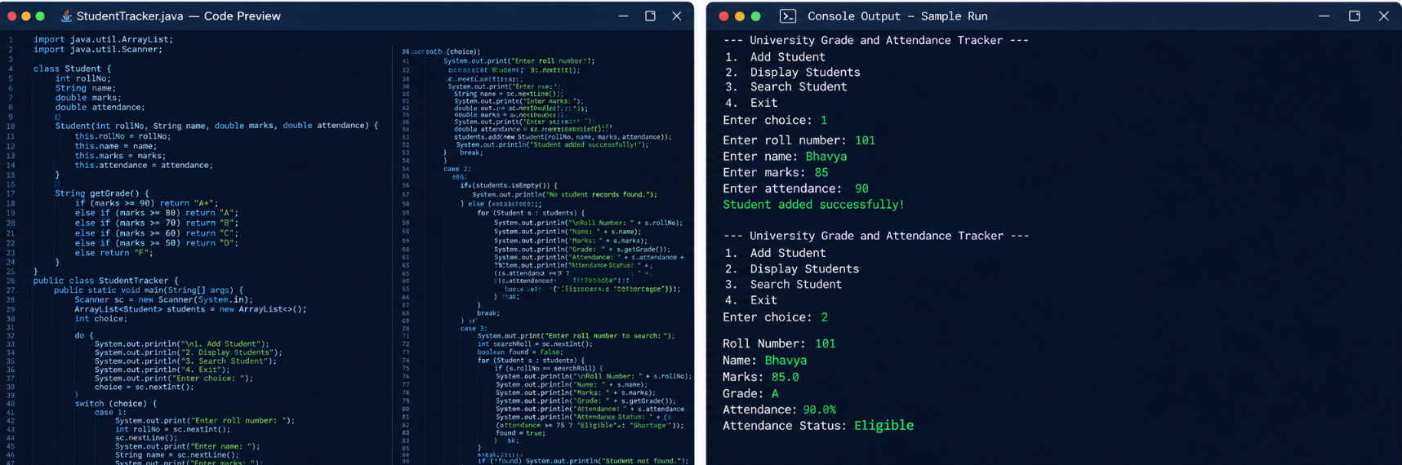
Screen Shots

Slide 12
Geo Tag Photo and git hub link

